Slide 1
Key Messages
NPA

Slide 2
Target NPA Client Types
Pharmaceutical companies
Generics houses
Regulatory authorities
Government
Academia
City (requires further analysis as new sector)
Consultative selling needed to probe for value to particular organisation

Slide 3
NPA Key User Groups
Senior Management
Marketing
Strategic Planning
Research & Development
Competitor Intelligence
Product/Brand/Portfolio Mgrs
Licensing
Pricing
F&A
Sales Management
International Liaison
Forecasters
Investor Community
Auditors

Slide 4
NPA Example Applications
Compare written versus dispensed dynamics Commercial impacts on market dynamics
Assess brand against generic prescribing
Gain insight into prescription fulfilment
International/Regional benchmarking
Licensing & Acquisition assessments
Alternative Bonus & Comp measure
Monitor prescription volume trends
Competition impact modelling
Guideline impact assessment
Message efficacy monitoring
Consultative approach needed to probe for value to particular organisation
Feedback on evolution of client data use also needed to cross-fertilise value added uses
National planning
Regional targeting
Pharmacy targeting
Licensing assessments
Reformulation potential
S&M ROI measurements

Slide 5
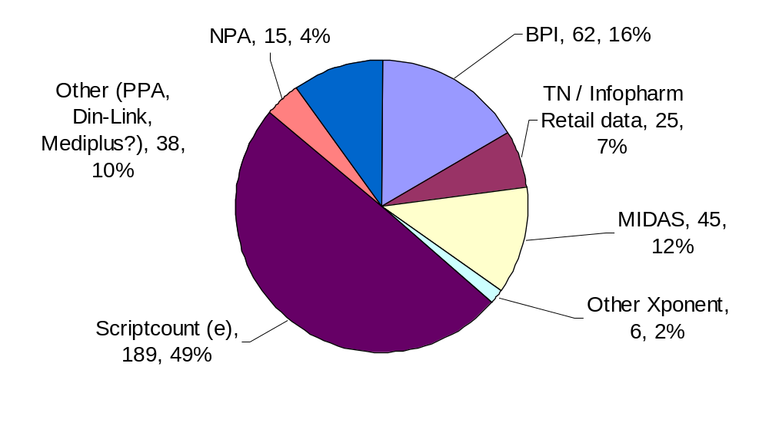
NPA Share of Current Client Numbers

Slide 6
Current NPA Client Segmentation
Total IMS Spend | High 4 $12,336 | 3 $0 | 1 $12,336
 | Medium 56 $197,282 | 50 $9,558 | 3 $58,589 | 3 $129,135
 | Low 290 $51,000 | 288 $4,500 | 2 $46,500
 |  | Low 341 $14,058 | Medium 6 $129,514 | High 3 $129,135
Client #s Service $ | Total NPA Spend
C
F
B
E
G
A
D

Slide 7
NPA Targeting
A – High Numbers with relatively low likely ROI potential. Focus on generic/mass marketing techniques with education/awareness theme. Consider EI as means of getting first BPI based data sales in.
B - KEY TARGET GROUP! Confidence in IMS demonstrated by overall spend? Understand reasons for lack of NPA data purchase – Competition? See next slide for messaging.
C – Average IMS client – identify characteristics from D/E for step move up, focus on expanding user base/routine reliance
D – Focus on cross-selling of other IMS services and maintaining usage of BPI services
E – Essential resource for IMS. Use for thought leadership on positioning, involve closely in R&D and message development, build user numbers

Slide 8
NPA Competition Messaging
Scriptcount
Largest competitor, lower coverage (1000 vs 6000?)!
Emphasise synergies with other IMS services:
    National and International comparability
    Synergies and continuity with BPI
  BPI/Retail Audits
Complementary, not substitutional. Rx vs Disp. offers analysis of MD/Pharmacy targeting
Longitudinal Patient data
Complementary vs substitutional. NPA provides standard National/International commercial measurement tool

Slide 9
NPA Potential Objections
Sample size
Still much larger than Script Count, and statistically valid. Internal IMS validation performed monthly. Local market conditions prohibit census coverage seen in other EU countries (Please consult with K Perera for detailed positioning)
Not contiguous with BPI
NPA measures prescription dynamics, rather than retail sales, so along with other methodological differences, the NPA is not expected to match the BPI, although trend comparisons are possible.

Slide 10
NPA Potential Objections cont’d
Trend data not differentiated from TN
Given respective sizes of the audits, IMS’s projection to a regional/national total has a statistically firmer foundation.
Consequently, whilst general macro trends may be similar between the two, actual data at more granular level may be more reliable
Why not rely on retail data?
The two data sources provide different information, and different reads on the market. Whilst the NPA cannot determine stock levels, for example, the BPI cannot deliver prescribed vs. dispensed information – crucial for evaluating message impact and market dynamics influencing buyer decisions

Slide 11
NPA Potential Objections cont’d
PLEASE: FEED BACK ANY OTHER OBJECTIONS YOU COME ACROSS SO THAT WE CAN DEVELOP EFFECTIVE RESPONSES FOR YOU!

